Slide 1
Public Health Nursing in Disaster and Emergency Response
Name
Institution

Slide 2
Introduction
Disaster is a sudden event that causes excessive damage.
Examples include fire, floods, earthquakes, etc.
Wildfires are very common in California during summer seasons.
Fires swept away forests, grasslands, and buildings, and people.
Specifically, Tubbs fires killed many people in Napa and Sonoma Counties.
EPA provided immediate response through recovery mechanisms.
Public health nurses also showed efforts throughout the phases of the disaster.
Notes:
Wildfires, floods, insect infestations, tsunamis, and other natural phenomena are detrimental disasters that can cause excessive damage to a large population. Northern California has been a victim, especially during hot seasons of the year when strong and powerful winds blow across Sonoma and Napa counties. The winds blow flames rapidly and the fire spreads at unprecedented rates, ending up destroying property of significant value and killing many people. After the Napa and Sonoma incident, EPA provided recovery support by removing asbestos and other hazardous materials from the buildings and residential areas to give space for renovations. Public health professionals played key roles in ensuring the safety of the affected populations.

Slide 3
Disaster
The Issue
Wildfires destroyed 200,000 acres of Napa and Sonoma, California.
Fires sparked Napa valley but the source remained under investigation.
Powerful winds pulled flames across the fields through Sonoma.
The hot, dry conditions might have resulted in the firestorm.
The fire occurred in California’s peak summer season.
The incident inflicted great loses in Santa Rosa City.
Notes:
The wildfire that leveled Sonoma and Napa was called the Tubbs fire, which occurred on October 2017, a hot summer season in North California. Other than the two counties, the destructive wildfire burnt parts of Lake counties, leading to the enormous loss of property of significant value in Santa Rosa City. The actual cause of the fire was unknown but the Department of Forestry and Fire Protection later affirmed that the private electrical system that is located adjacent to the one of the residential structures was the root cause of the disaster. Powerful winds that pulled across the crossways and fields were responsible for the rapid spread of the fires, leading to the evacuation of about 90,000 people and at least 40 dead immediately (Robinson, 2017). The fire occurred at California’s hot and dry season that was responsible for the fire because the private facility did not violate the Public Resources Code in the state according to investigations. Consequently, the whole event led to the loss of property of great value.

Slide 4
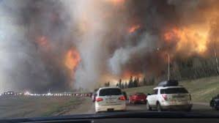
Photos
Notes:
Creative commons. (n.d). https://www.google.com/imgres?imgurl=https%3A%2F%2Fpressbooks.com%2Fapp%2Fuploads%2Fsites%2F104442%2F2018%2F04%2FLandscape_view_of_wildfire_near_Highway_63_in_south_Fort_McMurray-300x169.jpg&imgrefurl=https%3A%2F%2Fleadershipandinfluencingchangeinnursing.pressbooks.com%2Fchapter%2Fchapter-13-emergency-preparedness-and-response%2F&tbnid=OigF0aA_2Y9HSM&vet=12ahUKEwj7xLWTsdjnAhWRwYUKHeonD9EQMygDegUIARDhAQ..i&docid=qXQJDdaFTww48M&w=300&h=169&q=creative%20commons%20photos%20of%20public%20health%20nurses%20after%20fire%20disaster&ved=2ahUKEwj7xLWTsdjnAhWRwYUKHeonD9EQMygDegUIARDhAQ

Slide 5
Population Affected
The populations of Napa and Sonoma were the most affected by the fires.
Specifically Sonoma County lost 3,300 residents in October 2017.
The population declined became dramatic because people left the region.
About 2,207 residents further migrated to other regions.
The fires swept away about 3100 homes in Santa Rosa.
The fires led to housing crises in the counties.
Notes:
Approximately 3,300 residents of Sonoma County alone were lost to the fires of the October 2017 in California. The census Bureau estimated that people started to leave the region at unprecedented rate following the exodus of the fire incident. The Department of Finance later in December the same year, confirmed that about 2,207 residents had migrated from the region after factoring in the number of deaths and live births. Additionally, about 3100 families were rendered homeless and another 1500 homes were lost in Coffey Park (Krishnakumar, Fox, & Keller, 2017). The ultimate repercussion was that many homes remained homeless and home crises, especially in the devastated socioeconomic segments of the population and low-income residents.

Slide 6
Other vulnerable populations
Large fires have always scorched Camp Fire in California.
North of Sacramento’s population is also vulnerable to wildfires.
The vulnerability extends further to Northwest of Los Angeles.
Generally, California’s population lives in proximity to high-risk fire regions.
Santa Rosa is not an exemption owing to the increased urbanization.
The entire Northern California region is prone to wildfires.
Notes:
Northern California recorded 44 deaths due to wildfires, which destroyed many structures in the region. Many people tried to evacuate the region. Areas like Camp Fire and North Sacramento are also prone to wildfires as evident in the past incineration of the whole Paradise town. Also, Woolsey Fire also burnt northwest of Los Angeles and led to the closure of the Route 118 freeway. However, Camp Fire was marked one of the most destructive wild fires in California this century. The wildfires are common due to the hot climatic conditions and the summer of 2017 marked California’s hottest period in history as it was characterized by heat waves that extended up to September the same year.

Slide 7
Response
US EPA removed asbestos in 131 destroyed properties in Sonoma.
The asbestos removal activity extended to Napa, Lake, and Mendocino by December 2017.
EPA removed hazardous wastes in 6,551 properties in Sonoma and Napa.
For example, household catch fires, reactors, and explosives were removed.
Herbicides, oil, and batteries were safely disposed.
EPA launched a new tool for tracking disaster recovery progress.
Notes:
Sonoma and Napa counties developed multi-agency response to the wildfires disaster with the help of the US Environmental Protection Agency (EPA). The agency removed 131 asbestos in the destroyed properties in four counties including Sonoma, Napa, Lake, and Mendocino. The agency removed several other household items and products such as catch fires, reactors, those that can explode, and materials that are corrosive and contain toxins. For example, paints, solvents, oil, batteries and pesticides that contain hazardous chemicals were removed and safely disposed to reduce the dangers associated with them. Additionally, Napa County introduced advanced technologies that could show fire-affected areas and track progress in terms of disaster recovery initiatives in the field.

Slide 8
Response
EPA collects household hazardous waste containers.
Chemical drums are disposed at hazardous waste facilities.
EPA also collects HHPA in Sonoma and Coffey Park area and its neighborhoods.
Operations in Sonoma county extended to Mark West, and Fountaingrove.
Commercial and industrial parcels are also under recovery.
Organizing community meetings for sensitization in Sonoma and Napa counties.
Notes:
By October 31, 2017, EPA had collected over 8,300 hazardous wastes from household containers in Napa and Sonoma Counties. This initiative was part of the multi-agency response that strived to recover populations who were victims of the Northern California fires. EPA developed its staging areas in both Windsor and Yountville to ensure the proper disposal of hazardous wastes (Putra, Kep, Petpichetchian, & Maneewat, 2011). The agency also surveys, collects, and disposes any kind of hazardous waste in both Napa and Sonoma Counties as a way of guaranteeing safety among the affected populations. EPA works in collaboration with the federal government and it removes ash and debris contents while rebuilding destroyed structures in the two communities since the end of the fire incident. EPA also removes hazardous products and household leftovers. HHW collection was also conducted in Sonoma County Coffey Park including Mark West, Larkfield-Wikiup, and Fountaingrove.

Slide 9
Roles and Responsibilities of Public Health Nurse
Disaster mitigation phase
Public Health Nurse puts in place, measures to prevent disaster occurrence.
The nurse also averts the adverse effects of the disaster.
The nurse educates the public on disaster prevention techniques.
Creates awareness on activities that reduce or eliminate disasters.
Initiating immunization and public education programs.
Notes:
Public health nurses (PHN) are vocal in implementing measures that reduce or eliminate the adverse impacts of hazards. They often take provocative measures in case of the occurrence of a disaster and this starts with risk identification. Therefore, nurses evaluate the potential emergencies that can impact the demand for health services and supplies and they draw plans for addressing such issues ("Global Public Health," from Johnson and Johnson, 2018). They then inform the public of the potential dangers of the disaster and the best strategies for preparing for the adverse events. Nurse leaders then incorporate the disaster reduction measures in community planning to eliminate the vulnerabilities to hazards. The nurses also determine the likelihood of the vulnerabilities and sensitize the public on the best preparation strategies with a special focus on their consequences.

Slide 10

Creating awareness and education
Notes:
Creative Commons. (n.d). Roles in Disaster Management. https://www.google.com/imgres?imgurl=https%3A%2F%2Fwww.nlm.nih.gov%2Fdis_courses%2Finfo_roles%2Fimg%2Feoc_lrg.jpg&imgrefurl=https%3A%2F%2Fwww.nlm.nih.gov%2Fdis_courses%2Finfo_roles%2F02-000.html&tbnid=U_48-OX3gCAL0M&vet=12ahUKEwj7xLWTsdjnAhWRwYUKHeonD9EQMyhTegUIARC1AQ..i&docid=WmYWj_nQD_-7xM&w=1024&h=636&q=creative%20commons%20photos%20of%20public%20health%20nurses%20after%20fire%20disaster&ved=2ahUKEwj7xLWTsdjnAhWRwYUKHeonD9EQMyhTegUIARC1AQ

Slide 11
Roles and Responsibilities of Public Health Nurse
Disaster Prevention
nurses undertake all-hazards mitigation practices.
The prevention measures are both structural and non-structural.
They deter potential threats associated with the disaster.
They take action to eliminate the threats.
The nurses take part in developing, adopting, and implementing building codes and standards.
Notes:
Many PHNs take part in hazard vulnerability/risk assessment and improving security to mitigate hazards. They increase surveillance of both structural and nonstructural facilities to ensure safety. They continuously assess and identify the potential hazards and vulnerabilities among populations and institute both isolation and quarantine mechanisms. Some nurses introduce laws and regulations that curb deforestation in vulnerable areas to reduce flooding and potential wildfires that could easily spread to buildings and structures (Putra, Kep, Petpichetchian, & Maneewat, 2011). They also develop and create awareness among the people to adopt building codes and ensure compliance with the set standards to reduce the adverse impacts of hazards. These actions strengthen public infrastructure and ensure that communities are more resilient to catastrophic events.

Slide 12
Preparedness Phase
PHNs plan to respond to disasters based on command and control.
Nurses outline functional roles in both internal and external departments.
They also establish effective communication systems for addressing probable system failure.
Developing a legal basis to ensure that response includes isolation strategies.
A plan to prevent the spread of outbreak diseases.
Creating public education and awareness.
Notes:
Disaster command and control plans involve the designation of particular locations as command centers and assigning roles and responsibilities to ensure that nurses are aware of essential service. Additionally, PHNs develop standards for communicating the possibility of system failure. For example, they recommend various contingency processes including landlines, cellphones, and radios to be used as standard communication equipment. The legal basis for response ensures that nurses are able to initiate isolation processes, infection control, and allocate medical resources such as drugs to the affected populations. They also organize disaster preparedness training to prepare communities for emergencies. Finally, public awareness prepares the population for future disaster events and their consequences and it makes it easier to reduce morbidity and mortality among disaster-stricken populations.

Slide 13
Disaster Response Phase
PHNs act as the first responders during triage.
They conduct epidemiology surveillance for the good of the public.
They also conduct rapid needs assessments and offer assistance to populations.
PHNs communicate risks following a comprehensive surveillance.
They also help with medical surge capacity.
Offering first aid and related medical assistance.
Notes:
PHNs offer triage and related services including warning, mobilization, and evacuation to ensure that they meet the needs of the communities that have been affected by the disaster. Conducting epidemiologic surveillance ensures that the nurses are able to assess and communicate information regarding the health of the communities and the extend to which government agencies can lend a hand ("Building a Culture of Health," from Robert Wood Johnson Foundation, n.d.). Also, rapid assessments can rescue the lives of victims in emergency situation. This implies that PHNs communicate risks promptly as part of life-saving efforts that can rescue the people and their properties. However, the efforts are based on the prioritization of casualties based on a disaster triage strategy to ensure that there is an adequate allocation of treatments and accurate response to surge capacity issues (Putra, Kep, Petpichetchian, & Maneewat, 2011). First aid and medical assistance in emergency situations prevent further injuries and reinforce modes of communication while ensuring that the surveillance of infectious diseases is also underway.

Slide 14
Disaster Recovery Phase
PHNs conduct community assessment
They provide psychological support to the affected populations.
The PHN acts as a community and patient advocate following a disaster.
They empower staff and the community for further disaster management.
Providing continuum care and helping the victims.
Modifying disaster response plans to meet community needs.
Notes:
Recovery phase involves community assessment to determine the extent to which the disaster affected the community and trying to bring the conditions of the population back to normal. Continuum cares ensure that the affected populations can receive handouts and their concerns addressed after the occurrence of the disaster (Cunningham & Ali, 2013). PHNs also organize interview events to collect information about the affected populations and possible plan modifications to ensure that there is effective coordination of efforts within the community and address both psychological and public health concerns. By so doing, the nurses can lessen the adverse impacts of the events. This implies that PHNs advocate the needs of community members who experienced the impacts of disasters (Putra, Kep, Petpichetchian, & Maneewat, 2011). Policy reviews and changes ensure that nurses develop legislation that must be attained as part of competencies in disaster management when addressing the needs of community members.

Slide 15
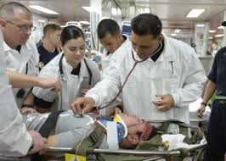
Continuum care
Notes:
Source: Harris, Y. (2017). Leadership and Influencing Change In Nursing. Chapter 13: Emergency Preparedness and Response. Press Books. https://leadershipandinfluencingchangeinnursing.pressbooks.com/chapter/chapter-13-emergency-preparedness-and-response/

Slide 16
Resilience
Empowering a community to resist hazards or accommodate their impacts.
Retaining the basic functioning of the community functioning.
Absorbing disturbances despite changes.
Managing disaster change by transforming living standards amidst stressors.
Empowering communities before the disaster becomes worse.
Notes:
Resilience is the ability of the affected community to adapt, absorb, or accommodate the adverse effects of a hazard or their capability to recover from the situation efficiently. If the affected populations can absorb the disturbances and retain similar basic structures that ensure the efficient functioning of the community while adapting to stress and dramatic changes then they are becoming resilient. Self-organization and the ability to adapt to the adverse situations arising from disaster events is a great achievement. Resilience further involves the capacity to absorb the dramatic changes associated with the impacts of the disaster while simultaneously undergoing change. Maintaining the living standards of the population following a disaster occurrence and in the face of stress.

Slide 17
Proposed Interventions
Building resilience among communities before the disaster worsens.
Encouraging conversations about disaster risk reduction.
Promoting efforts that are ahead of the curve
Promoting holistic support approaches to support sustainability strategies.
Increasing collaboration with organizations that build up resilience capacity.
Strengthening nurse leadership to support advocacy.
Notes:
It is crucial to empower communities that are facing social challenges such as poverty and poor housing to develop disaster recovery strategies before their conditions worsen. Conversations about disaster reduction should aim at creating awareness while considering the potential changes in the community and economic restructuring over time. Focusing on efforts that are above the curve is a way of promoting disaster philanthropy and communities will develop response strategies in the wake of catastrophic events. Holistic approaches to disaster recovery will prioritize the introduction of resilient organizations in communities to help the populations with sustainability strategies through the organizations’ resilient leaders. Such organizations will increase the build-up of resilience among communities that are vulnerable to disasters. Organizations that build resilience are keen on reducing future disaster occurrences.

Slide 18
Interventions
PHNs should be involved in all policy-making at both federal and international levels.
Nurses should be advocates for risk aversion strategies.
Disaster risk aversion strategies must include resilience-building.
promoting social justice and equity in accessing disaster aid.
Aligning national policies with the needs of disaster risk reduction.
Society-engagement and partnerships during disaster risk reduction.
Notes:
Disaster risk reduction, recovery, and response policies should consider both national and international standards while nurses should remain committed advocates for risk reduction. Response and recovery initiatives should focus on both private sector and all relevant stakeholders to reduce mortality and improve health. Building resilience must consider the personal safety and physical as well as psychological health and wellbeing of nurses (Harris, 2017). Social justice will ensure equality in health care provision to disaster victims and in the provision of support systems necessary for risk management. In policy development, youths and persons with disabilities must be considered and even those with chronic and life-threatening conditions to ensure that the policies manage risks affecting their affairs (Harris, 2017). Lastly, engaging communities in policy development and prioritizing risk aversion measures is a vital move that ensures collaboration in developing a link between relief and development planning to improve resilience.

Slide 19
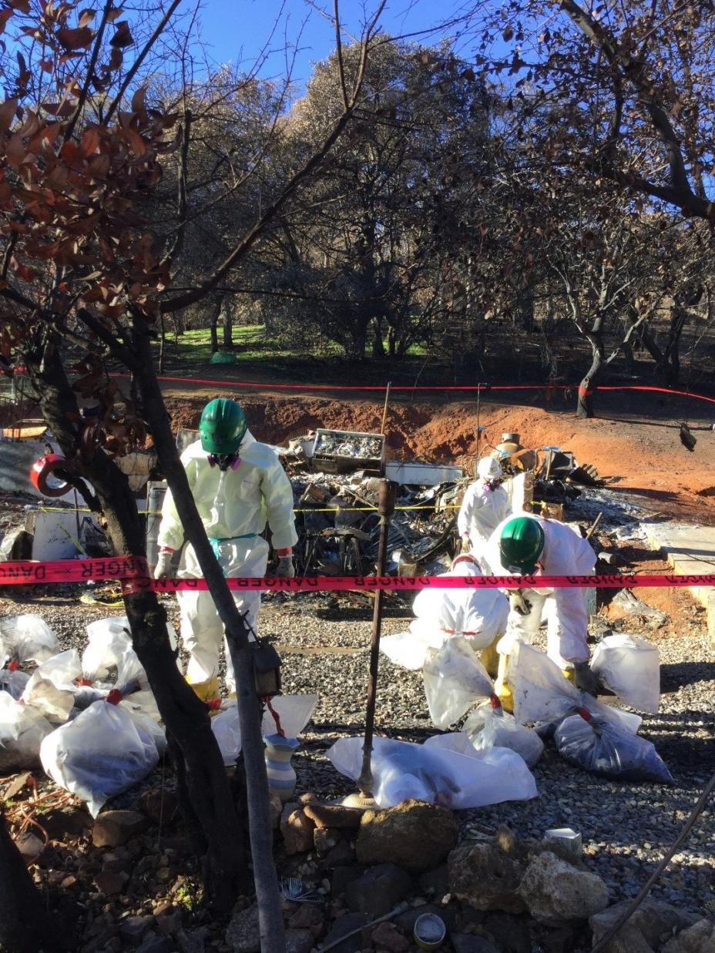
EPA Removing Asbestos from Damaged Property
Notes:
https://www.epa.gov/newsreleases/northern-california-fires-response-update-december-11-2017

Slide 20
Conclusion
Indeed, Public Health Professionals play vital roles in supporting disaster victims.
They develop measures to prevent disaster occurrence.
They create awareness through education to prevent disasters.
They conduct community assessment and act as patient advocates.
Provide continuum care and communicate risks to avoid disasters.
They collaborate with community-based organizations to help them build resilience.
Notes:
Public health nurses implement measures that reduce or eliminate the adverse impacts of disasters. They take provocative measures involving risk identification to develop strategies for averting such risks and ensure the overall safety of vulnerable populations. Awareness creation, education, and sensitization are vital elements that can reduce the adverse consequences of disasters and increase community preparedness to tackle and cope with future disasters. They also involve relevant stakeholders to reduce mortality and improve health. Additionally, they help patients and disaster victims build resilience while considering the personal safety, physical as well as psychological health and wellbeing of the victims.

Slide 21
References
"Building a Culture of Health," from Robert Wood Johnson Foundation (n.d.). https://www.rwjf.org/en/how-we-work/building-a-culture-of-health.html
Cunningham, M. & Ali. (2013). Bending the Cost Curve and Improving Quality of Care in America’s Poorest City," Population Health Management. https://lopes.idm.oclc.org/login?url=http://search.ebscohost.com/login.aspx?direct=true&db=ccm&AN=104229978&site=ehost-live&scope=site
"Global Public Health," from Johnson and Johnson (2018). https://www.jnj.com/global-public-health
Harris, Y. (2017). Leadership and Influencing Change In Nursing. Chapter 13: Emergency Preparedness and Response. Press Books. https://leadershipandinfluencingchangeinnursing.pressbooks.com/chapter/chapter-13-emergency-preparedness-and-response/

Slide 22
References
Krishnakumar, P., Fox, J., & Keller, C. (OCT. 23, 2017). Los Angeles Times. Northern California Fires Structures. [UPDATED OCT. 25, 2017]. https://www.latimes.com/projects/la-me-northern-california-fires-structures/
Putra, A., Kep, S., Petpichetchian, W., & Maneewat, K. (2011). Review: Public Health Nurses’ Roles and Competencies in Disaster Management. Nurse Media Journal of Nursing, 1, 1, 1 – 14. https://pdfs.semanticscholar.org/2dd3/91410695840a5186703905894acbe07a82eb.pdf
Robinson, M. (Oct 16, 2017). Business Insider. 3 key reasons explain how the massive firestorm in California became one of the worst in state history. https://www.businessinsider.com/why-were-the-napa-sonoma-fires-so-bad-2017-10?IR=T

